Slide 1
Used Car Sales Analysis
"Unlocking Market Trends: Helping Buyers and Sellers Make Smarter Decisions."
Project By
BAIG MANZOOR

Slide 2
Project Objective
The objective of the “Data Analytics Study of Used Car Sales Analysis” project is to conduct an in-depth analysis of trends and patterns in the used car market.
The aim is to analyse sales data to uncover key factors influencing car sales, optimize pricing strategies, and provide actionable market insights.
These insights are intended to help dealerships, buyers, and policymakers make informed decisions and improve the efficiency of the used car market ecosystem.
The data was collected from the 'Car Dekho' website using Python-based web scraping to generate structured datasets.

Slide 3
Main Agenda
1. Data collection through web scraping and open datasets.
2. Data cleaning, preprocessing, and modelling in Python Using Visual Studio.
3. Creating impactful visualizations in Power BI to uncover actionable insights.
The scope of this project includes the following key areas like Data Collection from the ‘Car Dekho’ Website using Python Based web Scraping by Visual Studio, Price Variation Analysis, Brand Perception and Its Impact on Pricing, Market Trends and Consumer Behaviour, Recommendations for Consumers.

Slide 4
Tools and Technologies
Software Requirements
1. Excel
2. Python (Visual Studio)
3. Power BI
Main Software Libraries
1. Beautiful Soup
2. Requests
3. Openpyxl

Slide 5
Introduction
Overview of project:
Data collection through web scraping. Data cleaning, preprocessing, and modelling in Python Using Visual Studio. Creating impactful visualizations in Power BI to uncover actionable insights.
Importance of Analyzing Used Cars Data:
Explore the factors influencing the price variation among used car brands (e.g., brand reputation, mileage, age, age of the car, and market demand).
Importance of web scraping and data preprocessing and data visualization:
Web scraping is used to extract the data form the websites. Visualization tools like Power Bi make complex datasets easier to understand and communicate, enabling data-driven decision-making.

Slide 6
Web Scraping
Step 1: Importing Libraries
import requests # HTTP requests :-web scraping or interacting with web
from bs4 import Beautiful Soup # HTML parsing using Beautiful Soup : pulling data out of HTML and XML files and searching and modifying phrase tree
import openpyxl # The openpyxl library in Python is used for working with Excel files
from openpyxl import Workbook # The Workbook class from openpyxl is used to create a new Excel workbook
Step 2 : Opening Excel Sheet
excel = openpyxl.Workbook() # Opening the new workbook
sheet = excel.active # setting up the active sheet to add the data
Step 3 :Adding columns names to the sheet
sheet.append(["Car Name","Car Company","Price","Purchased Year","Fuel","Kilometers Travelled","Transmission","Location"]) # appending column names in the active sheet

Slide 7
.
Step 4 : CHECKING THE ACCESS OF URL
headers = {'User-Agent': 'Mozilla/5.0 (Windows NT 10.0; Win64; x64) AppleWebKit/537.36 (KHTML, like Gecko) Chrome/116.0.0.0 Safari/537.36 Edg/116.0.1938.54'}
Step 5 : URL TO EXTRACT THE DATA USING SOUP OBJECT
Hundayi_data = requests.get("https://www.cardekho.com/used-hyundai+cars+in+hyderabad",headers=headers)soup = BeautifulSoup(Hundayi_data.text, "html.parser") # Hyundai cars in hyderabad
Hundayi_Banglore = requests.get("https://www.cardekho.com/used-hyundai+cars+in+bangalore",headers=headers)
B_Hundayi = BeautifulSoup(Hundayi_Banglore.text,"html.parser") # Hyundai cars in Bangalore
Step 6: Extracting all the Hyundai Cars from the path
Hundayi_cars = soup.find("body").find("div",class_="listViewCard").find("div",class_="gsc_row")\
.find_all("div",class_="gsc_col-xs-12 gsc_col-sm-6 gsc_col-md-4 cardColumn")
Step 7: Using for Loop to extract all the details of car
for car in Hundayi_cars:
try: name=car.find("div",class_="NewUcExCardposR").find("div",class_="title_heart_section").find("h3",class_="title")\
.find("a").text.split(" ") # To extract the name of the car

Slide 8
.
name.pop(0)
result=""
for string in name:
result+= " "+string
Car_company=car.find("div",class_="NewUcExCardposR").find("div",class_="title_heart_section").find("h3",class_ ="title")\ .find("a").text.split(" ")[1] # To get the Company name of the car
price = car. find("div",class_="NewUcExCard posR").find("div",class_="Price hover").find("p").text.split(" ") [0].split("₹")[1] # To extract the price of the car
purchased_year=int(car.find("div",class_="NewUcExCardposR").find("div",class_="title_heart_section").find("h3",class_="title")\.find("a").text.split(" ")[0]) # To get the year of the car that is purchased
fuel=car.find("div",class_="NewUcExCardposR").find("div",class_="title_heart_section").find("div",class_="dotsDetails")\.text.split("•")[1] # To get type of fuel of car (eg: petrol or diesel)
travelled = car. find("div",class_="NewUcExCard posR").find("div",class_="title_heart_section")\
.find("div",class_="dotsDetails").text.split("•")[0].split(" ")[0] # To get the kilometers travelled of the car
Transmission=car.find("div",class_="NewUcExCardposR").find("div",class_="title_heart_section")\
.find("div",class_="dotsDetails").text.split("•")[2] # To get type of transmission of the car
location = car. find("div",class_="NewUcExCard posR").find("div",class_="distanceText").text.split(",")[1]
# To extract the location of car availability

Slide 9
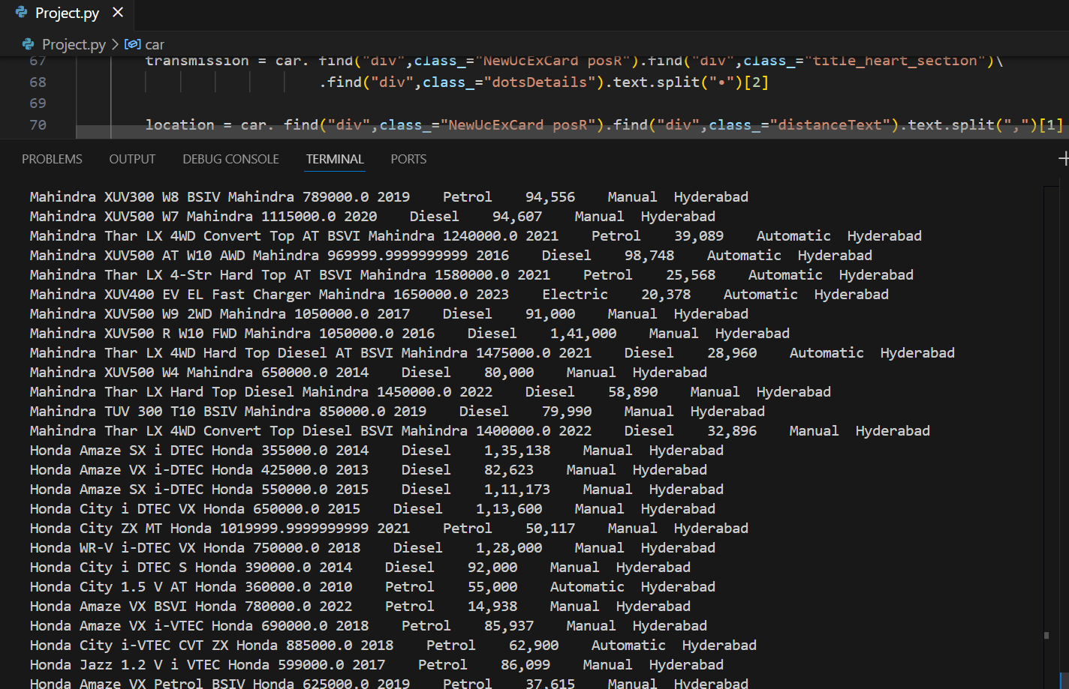
.
Step 8: Printing the classes to extract the data
print(result,car_company,float(price)*100000,purchased_year,fuel,travelled,transmission,location) # extracting the data using classes from the website
Output:

Slide 10
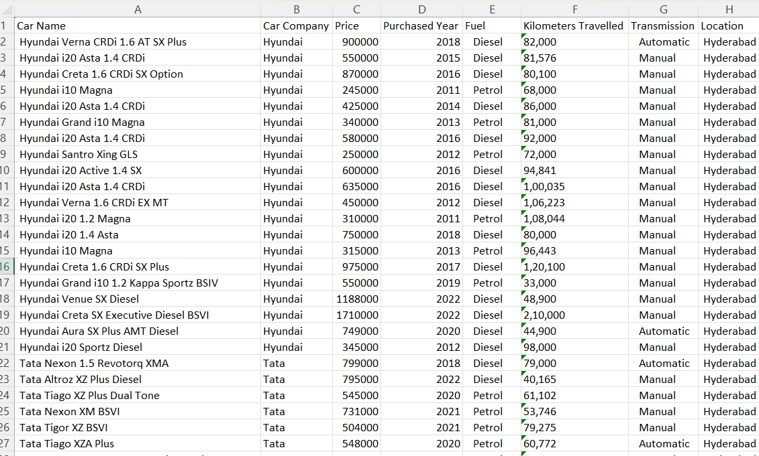
.
Step 9 : Appending data extracted to the columns in the excel sheet
sheet.append([result,car_company,float(price)*100000,purchased_year,fuel,travelled,transmission,location])
except:
continue
Output:

Slide 11
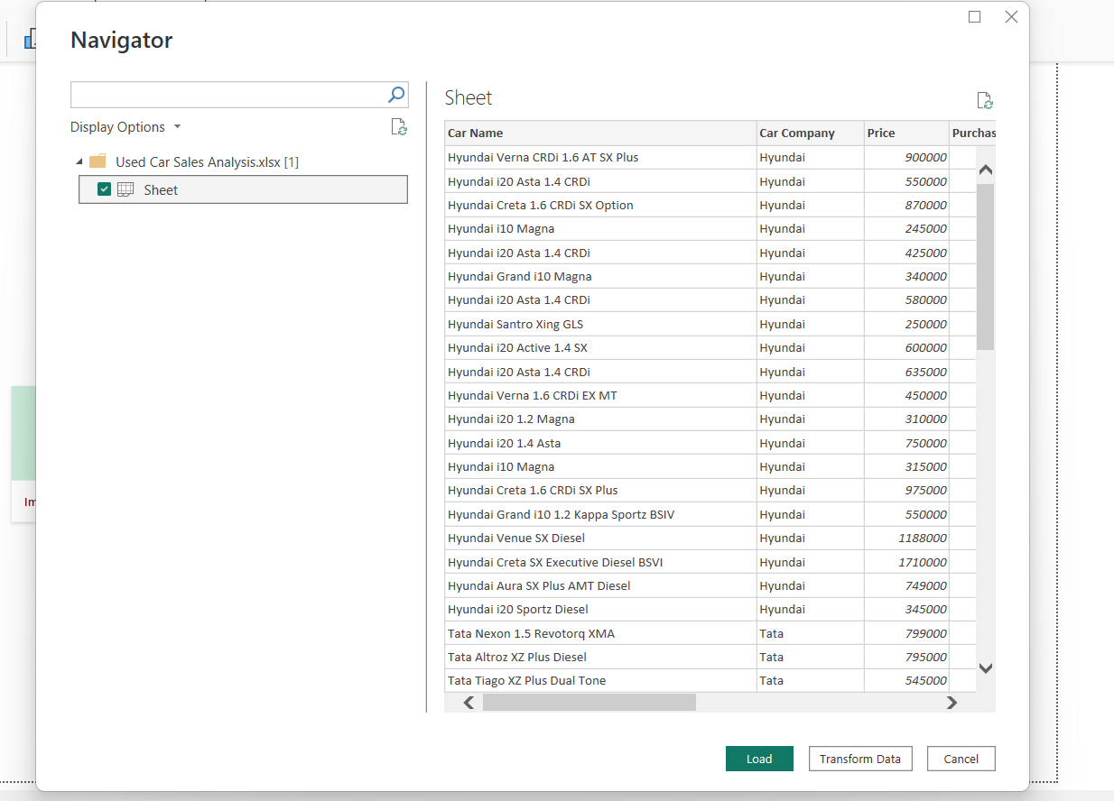
Preprocessing 1.Import Data:

Slide 12
.
Load Data: Import datasets related to Used Car Sales Analysis from sources like Excel, CSV files, or SQL databases into Power Bi.
Data Preview: Review the dataset in Power Bi to understand its structure, including columns such as Car Name, Car Company, Price, Purchased Year, Fuel, Kilometers Travelled, Transmission, Location.
2. Data Cleaning:
Remove Duplicates: Eliminate any duplicate entries to ensure the dataset's integrity.
Handle Missing Values: Identify Missing Values, Drop Missing Values, Impute Missing Values
Remove Rows: If null values are minimal, consider excluding rows with missing data.
Replace Values: Fill missing fields using mean, median, or default values to maintain consistency.
Correct Errors: Rectify incorrect data entries or typos to enhance accuracy.

Slide 13
.
3. Data Transformation:
Change Data Types : Update data types where necessary (e.g., ensuring numerical values for Travelled Kilometers or price).
Rename Columns : Assign meaningful column names to improve readability and align with the analysis objectives.
4. Filtering:
Filter Rows: Use Power Bi’s filter options to eliminate unnecessary data. This step ensures the dataset focuses on relevant information for analysis.
5.Data Visualization:
Leverage Power Bi features to create visualizations such as bar charts, slicers, cards and Line chart to analyze trends, Prices, and brand reputation among car of Bangalore and Hyderabad.
Customize dashboards for an intuitive understanding of insights.

Slide 14
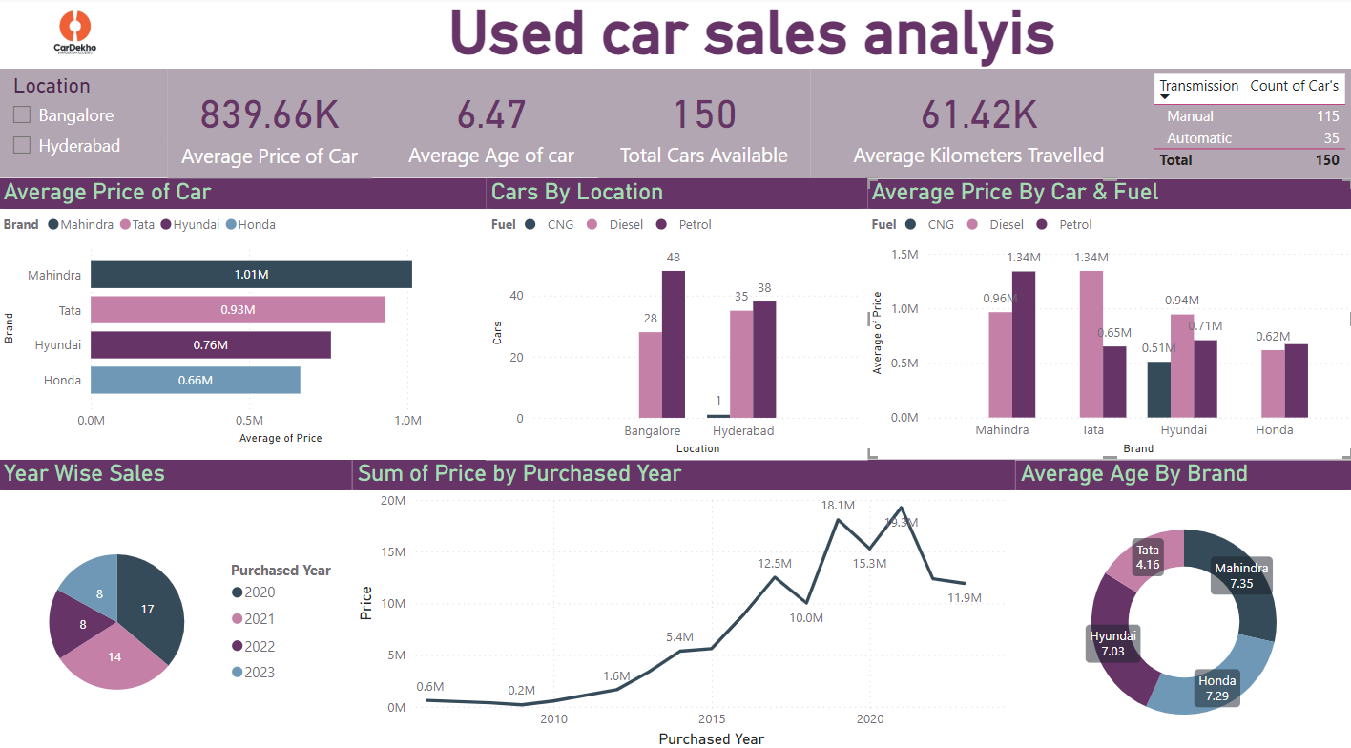
.
Dashboard

Slide 15
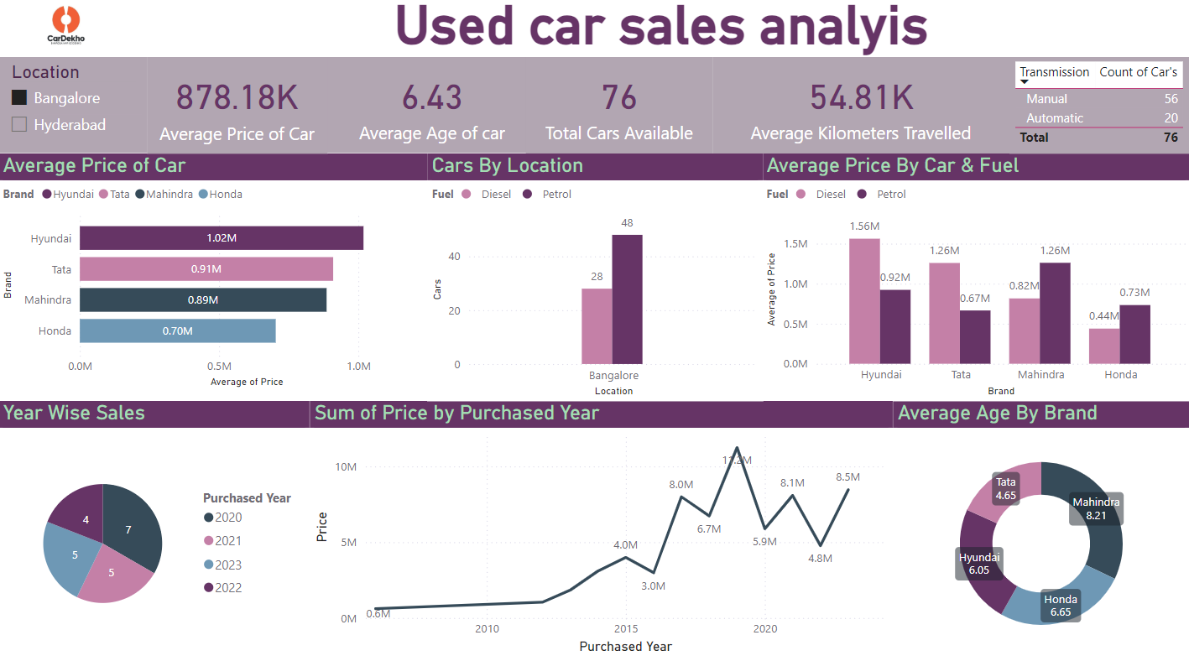
Bangalore

Slide 16
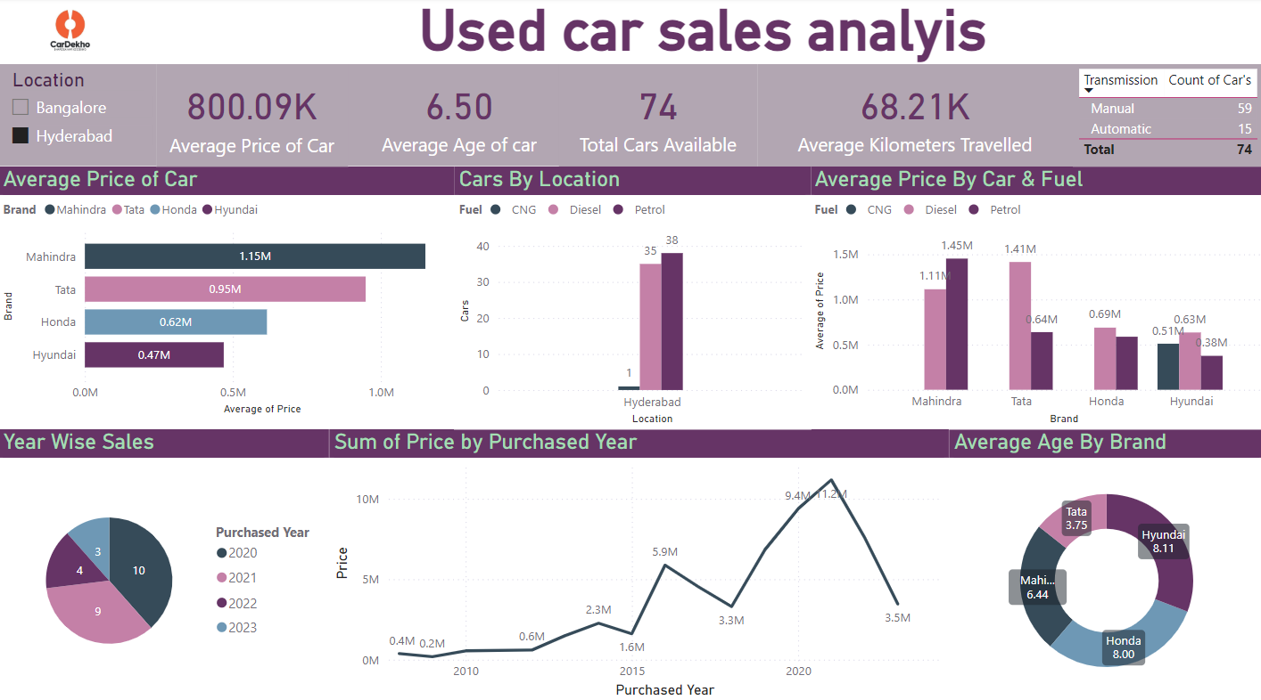
Hyderabad

Slide 17

Thank You..

